Slide 1
Living With and Accommodating a Hand Injury: A Personal Experience
Paul Leverenz, M. S.
Vice President, Vocational Services
Easter Seals Wisconsin

Slide 2
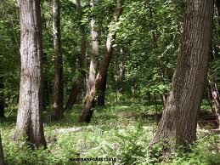
Background
Owned 60 acres of wood land
Practicing sustainable forestry
Desired to grow and market materials locally
Sawed approximately 70,000 board feet of lumber per year

Slide 3
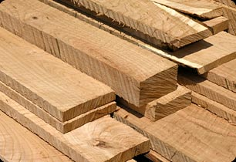
Background
Own and operate a portable sawmill
Custom cutting for others
Sawing my own logs to fill local orders
Trailer decking, barn beams and floors, hay wagon material
Specializing in local, sustainably grown lumber
Work schedule:
Nights, weekends and vacations

Slide 4
Background
My injury took place Friday October 13, 2000
Sawing logs on the portable sawmill at my home
Saw blade caught my glove and pulled my hand into it
Resulting injury:
A cut completely through the tendons on my left hand
And 40-70% through the bones, depending on the finger

Slide 5
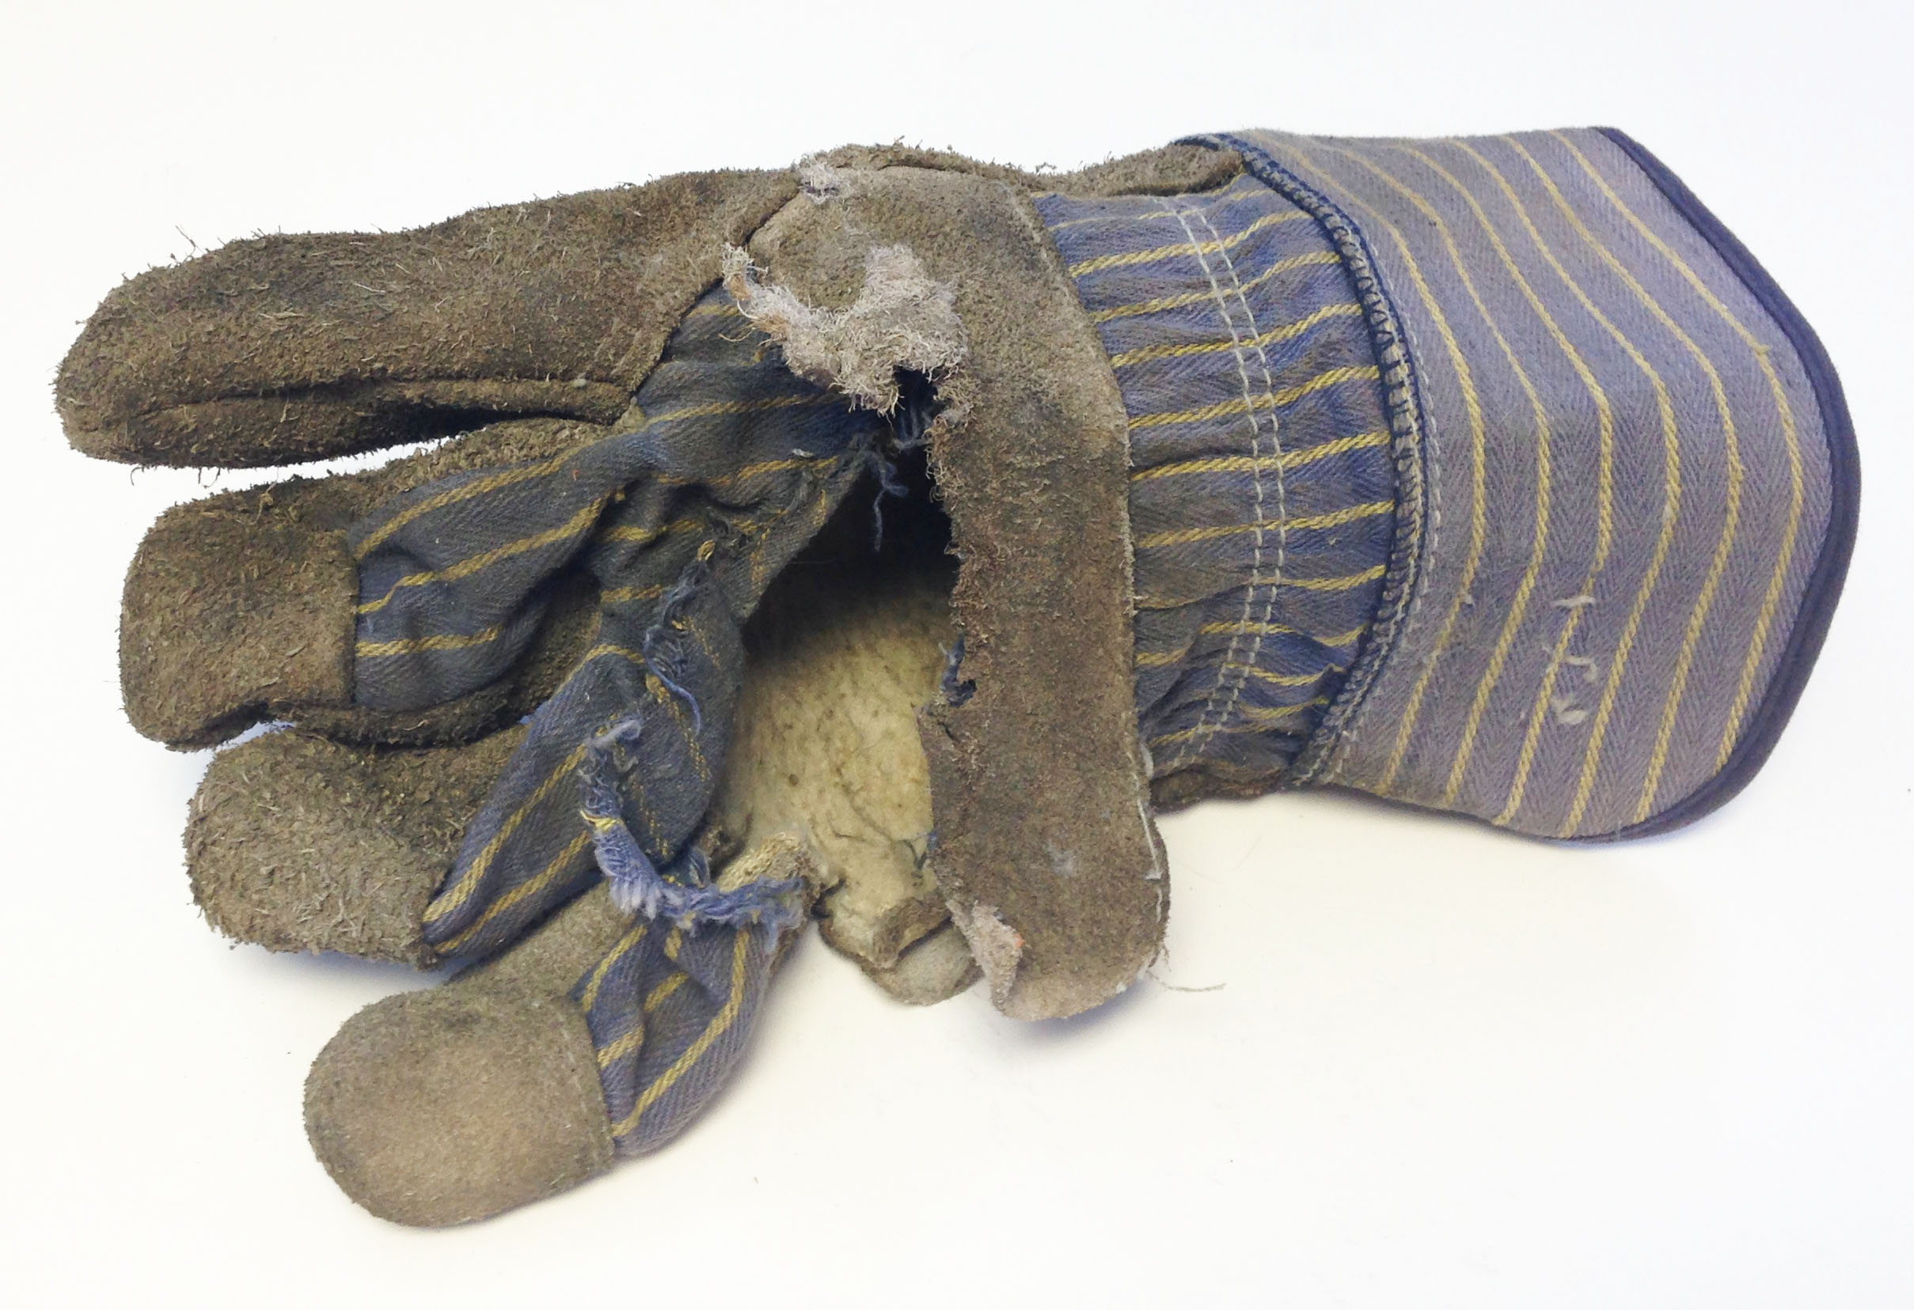

Slide 6
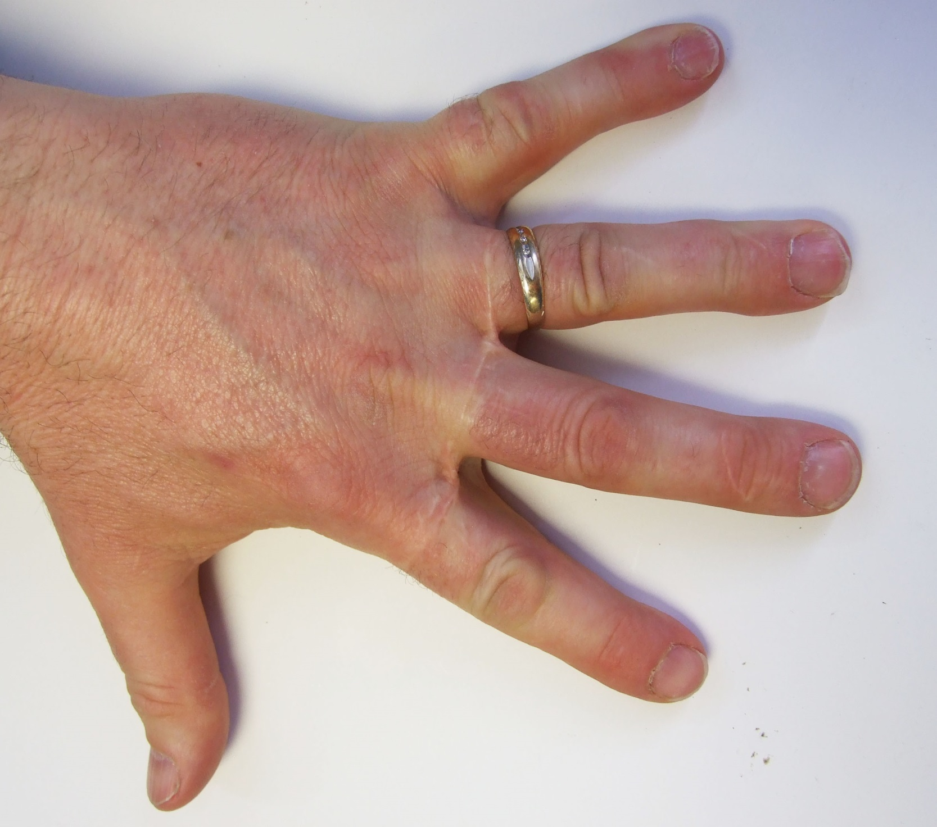

Slide 7
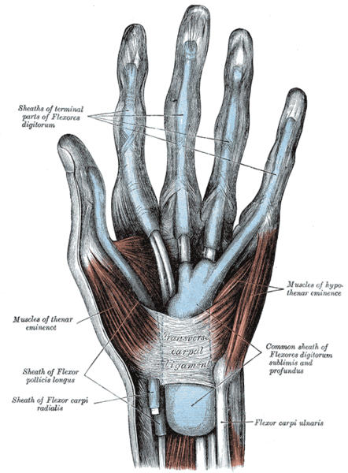

Slide 8
Expectations
Farm families work through injuries and pain
Sew me up I’ll get back to work
Nothing will change, the work needs to get done and I will do it
Physical therapy was 40 miles away
5 days a week for the first month
3 days a week for 3 weeks
2 days a week for 2 weeks
1 day a week for 2 weeks
No driving during the first month
Depended on others to take me to therapy

Slide 9
Expectations
Pain management consisted of narcotics
Against habit forming drugs
Could not stay ahead of the pain
Abilities
Thought that if I doubled exercises given at home that healing would be twice as fast
Abilities seriously diminished, had to ask for help

Slide 10
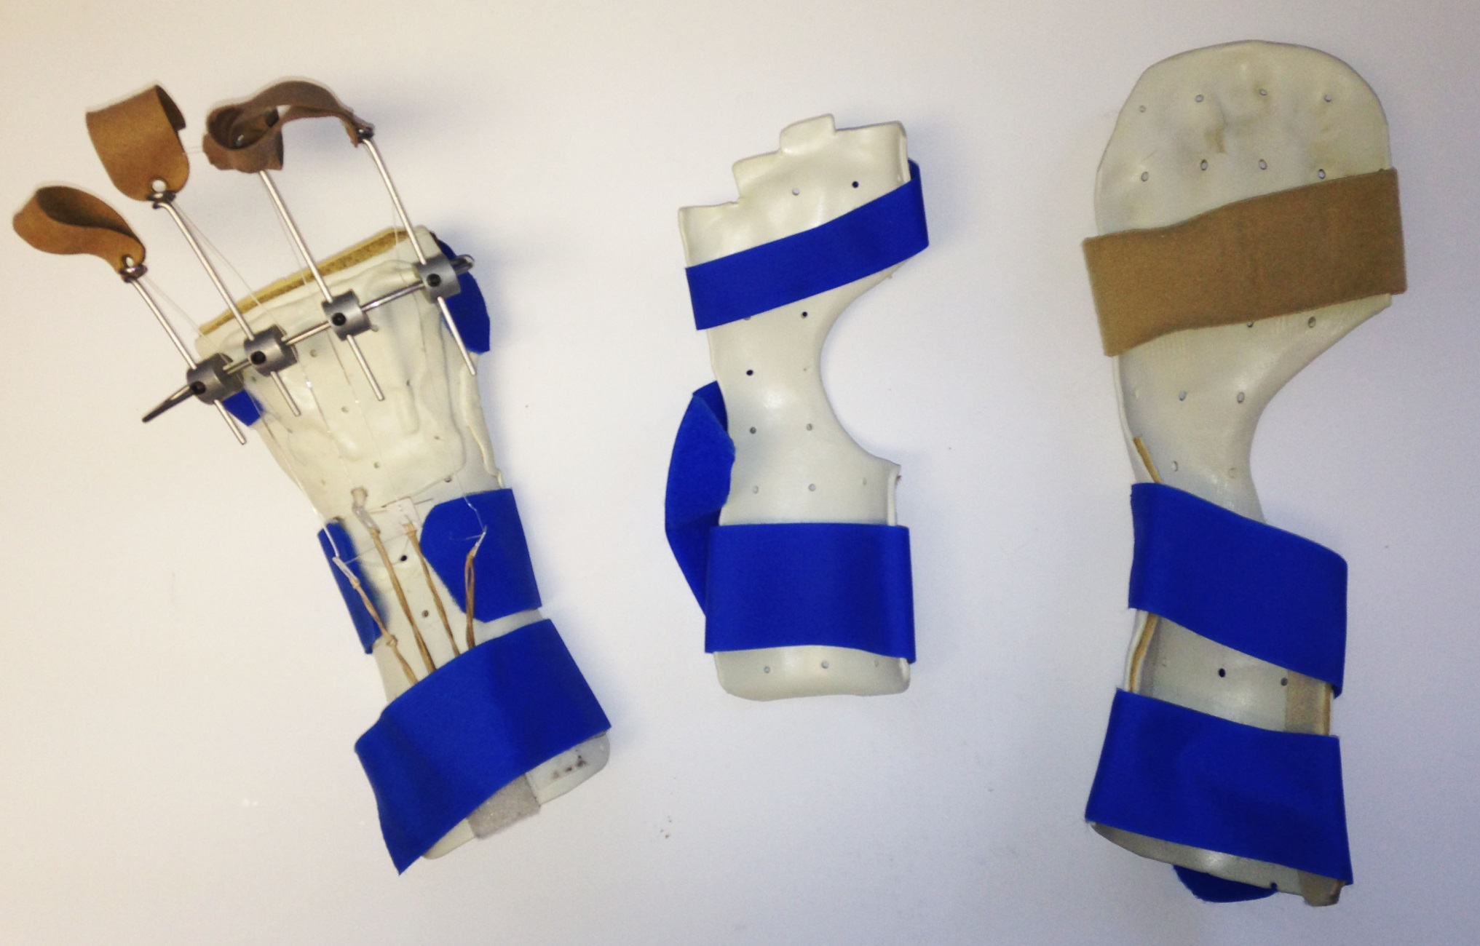

Slide 11
Complications
Excessive scarring
Significant swelling
Tendons “stuck”
Significant and increasing pain intensity

Slide 12
Complications continued
Reflex Sympathetic Dystrophy
Symptoms of RSD often begin days or weeks after an injury, usually in an arm or leg which has been injured. The symptoms may include:
Unexplained intense pain, out of proportion to the injury
Swelling
Altered skin temperature, either warm or cold
Altered skin color
Reduced motion of the affected part, and movement makes the symptoms worse
Sensitivity to touch
Abnormal sweating
Treatment of RSD is most effective in the earlier stages

Slide 13
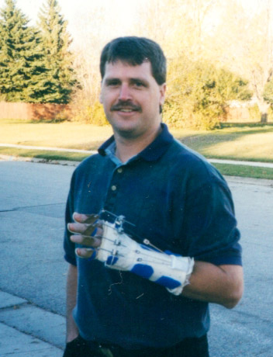
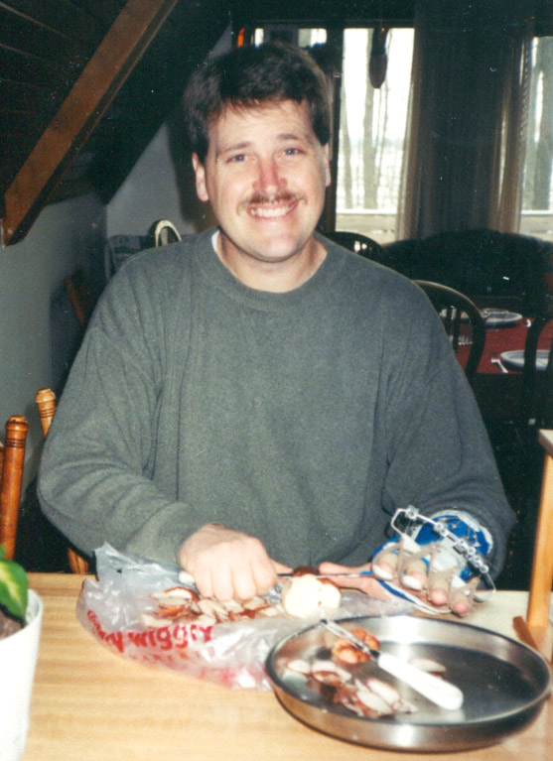

Slide 14
Adjustment to Disability
I am no longer a whole person
Can’t do all the things I thought I would get to do
Lost dreams, i.e.; playing guitar
What value do I have to my family?
What will my quality of life be?
Spiritual questions

Slide 15
Finding Hope
Support of family and friends
Desire to do all that I “used to do”
Looking for spiritual understanding
Measure of a man

Slide 16
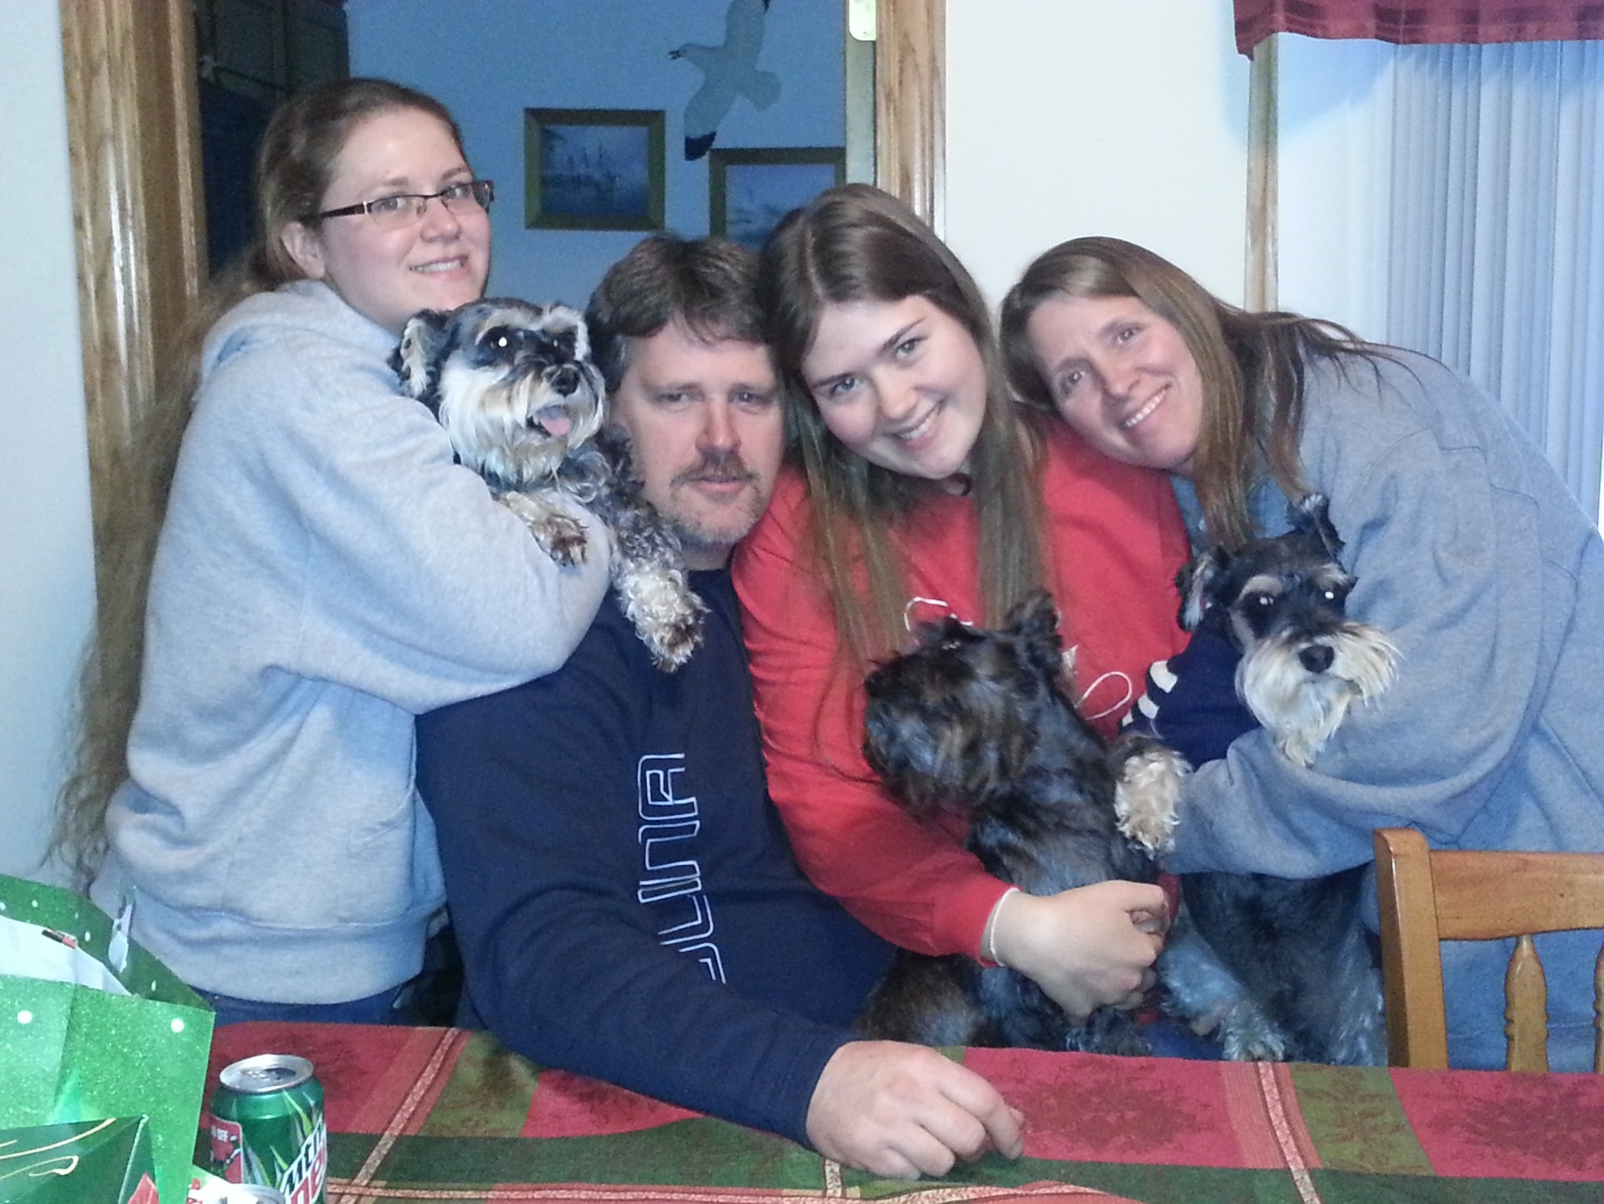

Slide 17
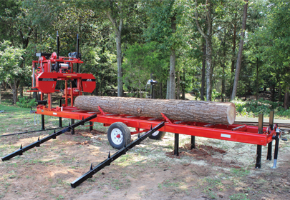
From Manual Sawmill

Slide 18
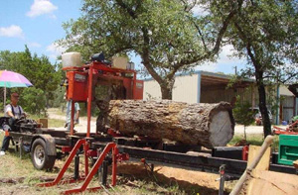
To Hydraulic Sawmill

Slide 19
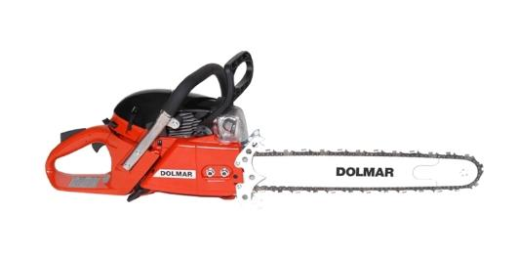
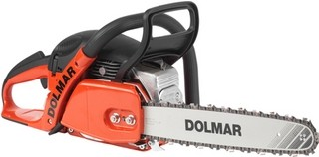
Accommodations
Dolmar PS-7300 Chainsaw
Specifications:
Displacement: 72.6 cc
Horse Power: 5.7
RPM: 13,500
Weight: 13.6 lbs
Dolmar PS- 5105 Chainsaw
Specifications:
Displacement: 50 cc
Horse Power: 3.9
RPM: 13,800
Weight: 11.9 lbs

Slide 20
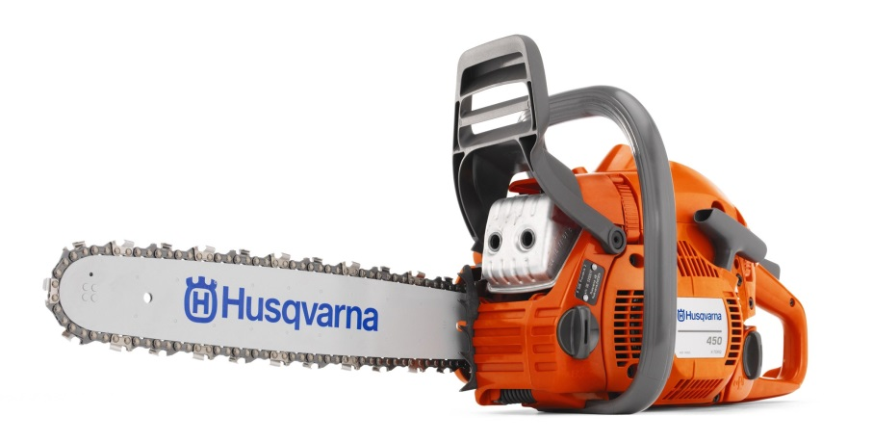
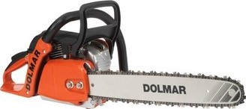
Accommodations
Husqvarna 450-e Series
Specifications:
Displacement: 50 cc
Horse Power: 3.2 HP
RPM: 9000
Weight: 11.33 lbs
Dolmar PS-420
Specifications:
Displacement: 42cc
Horse Power: 2.7 HP
RPM: 13,500
Weight: 10.56 lbs

Slide 21
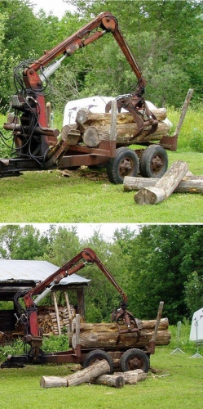
Accommodations
Log Trailer

Slide 22
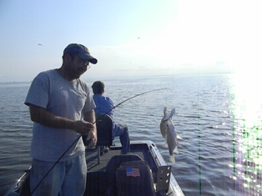
Change is not all bad
Dexterity was diminished, needed help with mechanical repairs
Now trade services with
a mechanic in the
neighborhood
Also now take time off to
fish with neighbors

Slide 23
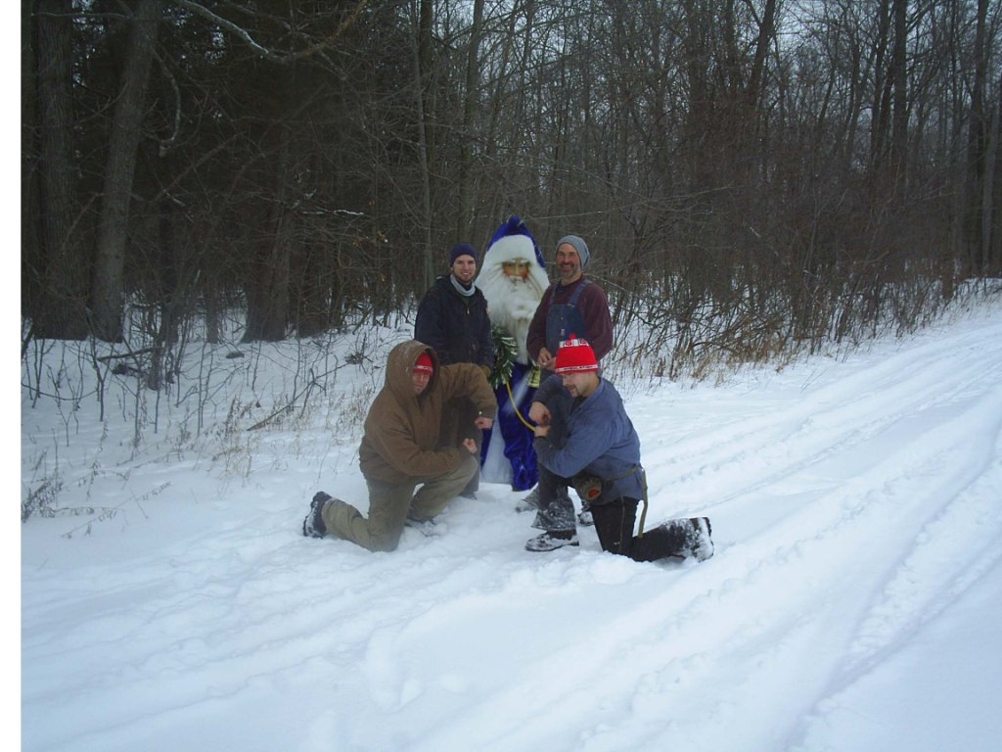
Change
Needed help with cutting wood for heating
Neighbors helped (now is an annual get-together)

Slide 24
Attitude is key
Letting people help is good for all parties
Makes a better community

Slide 25
Knowledge of accommodations
Before accommodations are provided
Research what is available, think beyond what you and the consumer know
New equipment
Improvements on old equipment
Verify that the accommodation fits the disability
The farmer may not be aware of what is available and may not have tried what would be best suited for the particular situation

Slide 26
Lessons learned
I am not super man
Life is still good, just different
Family and friends are critical to my success
My ability to accept help is critical to my success
Who I am is not dependent on what I can do

Slide 27
Lessons learned related to work
I can accomplish as much work now as I did before the injury, I just need to do it differently
The above statement is a good thing not a bad thing
Smarter not harder is a good goal
Incorporating my disability limitations into work process planning leads to better outcomes and greater work satisfaction

Slide 28
My support

